Slide 1
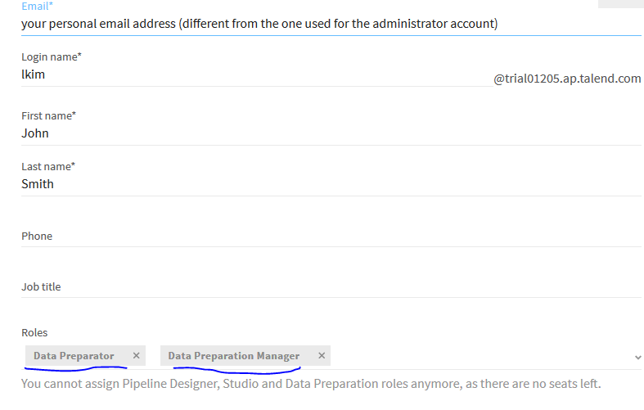
Talend Cloud Data Preparation
Preparing data using Data Inventory and Data Preparation
1)Give the Data prep all permissions to the user
*Click Select an app on the upper left section of the page and select Management Console on the drop-down menu.
*click the user and passwords and add the roles.
*logout and login again.

Slide 2
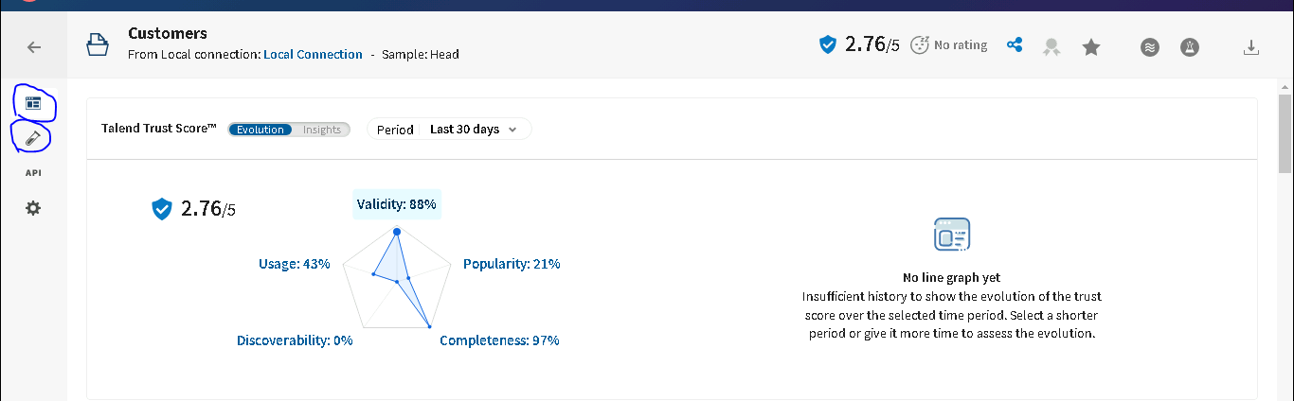
2)Connecting to Data Preparation
Goto Talend data preparation.
Click Datasets
Create a dataset.
Click the Drop a file or browse button.
Verify that the Overview tab of the Customers dataset opens.
Click the back arrow to go to the list of datasets
Verify the overall quality of the dataset.

Slide 3

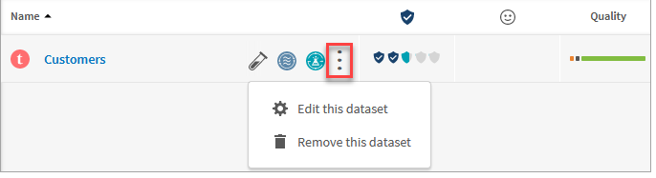
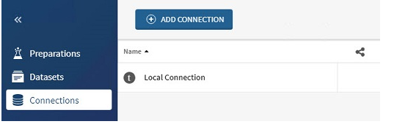
Verify the overall quality of the dataset.
Green for data that matches the column format
Orange for data that does not match the column format
Black for empty cells
Verify the Trust Score of the dataset.
To edit or remove the dataset, mouse over the dataset, click the three dots button to open the menu.
local connection is also created when uploading a file as a dataset.

Slide 4
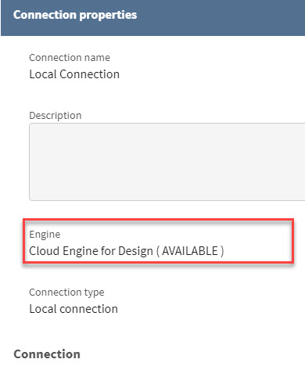
Click Local Connection to open the Connection properties.
Also add the database connection and another connections

Slide 5
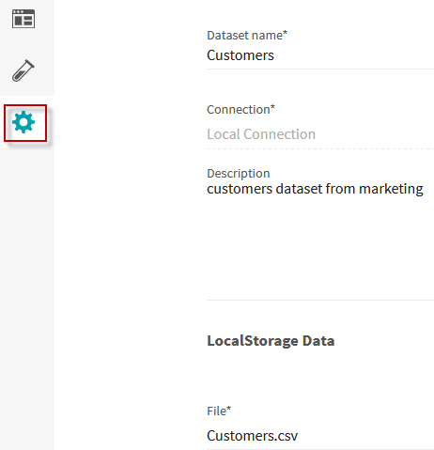
Explore the customers dataset
Click the dataset name to open its details.
Description - allows users to define a description for the dataset.
Details - describes creation/update details of the dataset.
Data quality - gives a quick view of the overall quality of the data.
Rating - presents individual and global rating score of the dataset.
Custom Attributes - allows users to add metadata information and can also be used to help users search and sort the datasets.
Click the Configure button on the left menu if you need to review or modify the configuration of the dataset.

Slide 6
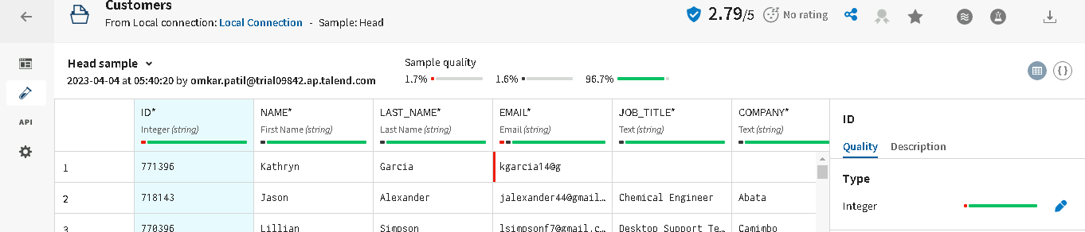
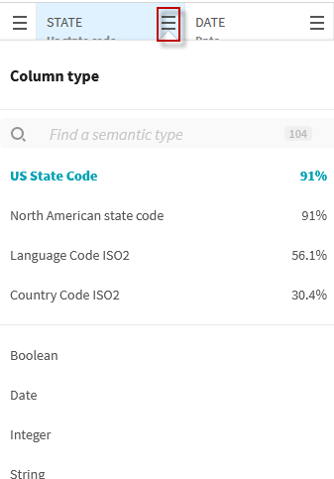
Click the Sample button on the left menu to display the sample data.
Explore the semantic types. The semantic type indicates what the data in a column represents.

Slide 7


Change the presentation format for the data sample.
Check the overall quality of the dataset on the top bar.

Slide 8
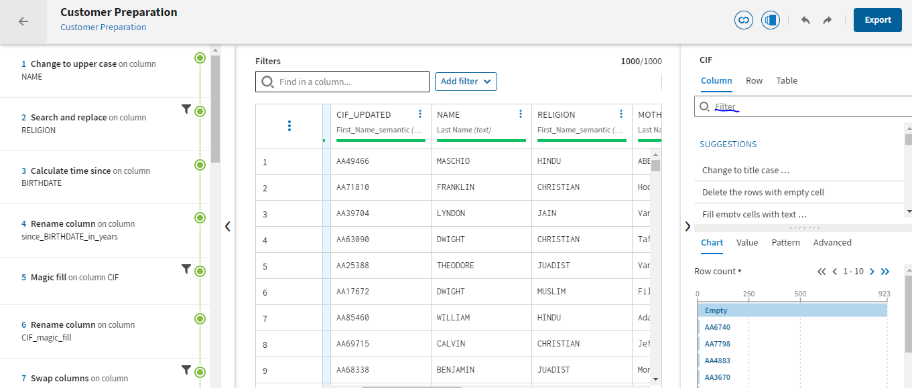
Add steps to the preparation
Select the table and apply the filters to remove raw data.

Slide 9
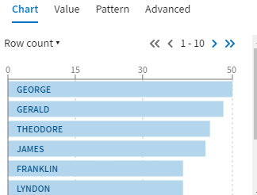
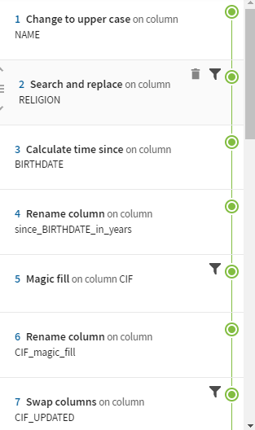
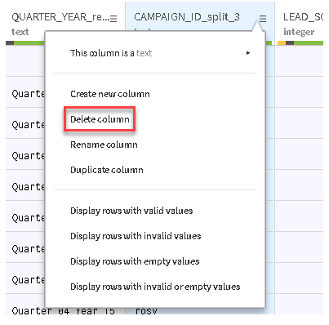
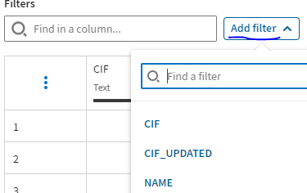
Correct invalid values in different pattern.
Different filters will be applied for the data
Display different filter options from colums.
We can apply the filter and clean the data.

Slide 10
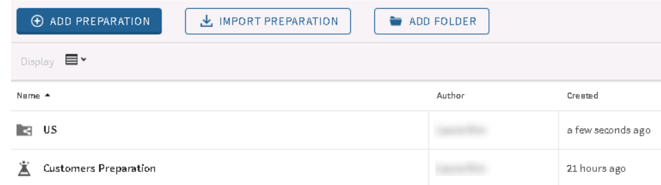
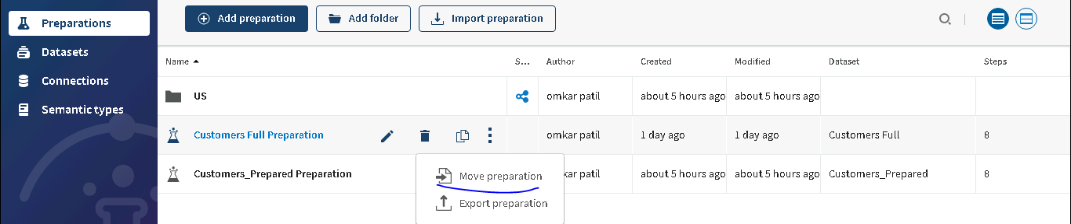
Move the data preparation
Click the ADD FOLDER button
Enter Folder Name and add the folder.
Move the Customers data preparation to the US folder

Slide 11

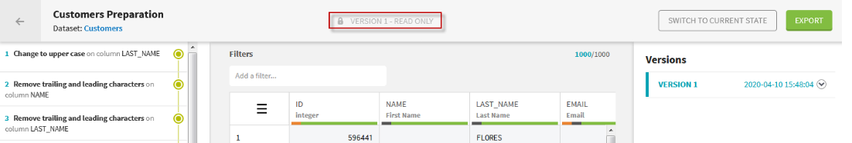

Create a preparation version
Click the MANAGE VERSIONS button.
Click the ADD VERSION button.
The version opens in read only mode.
To leave the read only mode, click SWITCH TO CURRENT STATE.

Slide 12
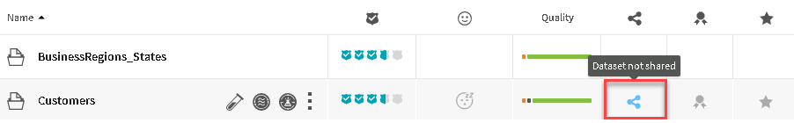
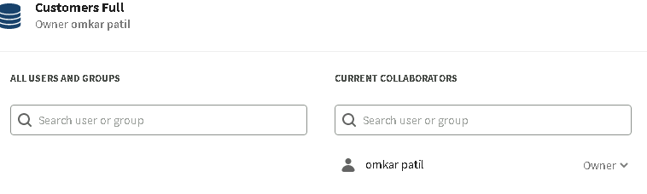
Share datasets
Open Datasets and click share button
On the All users and groups list, select Group DataPrep and click the + button to add it to the Current Collaborators list.
The group is added to the Current collaborators list.

Slide 13

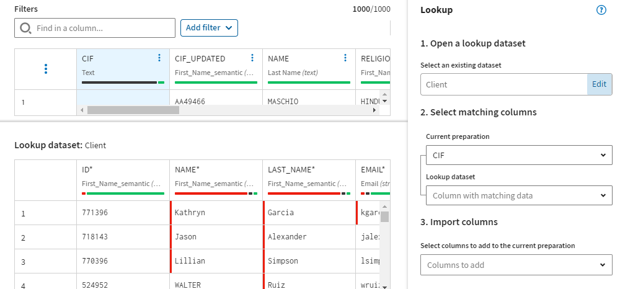
Adding a join to the data preparation
Add a second dataset, by lookup.
Create a join between two datasets.

Slide 14

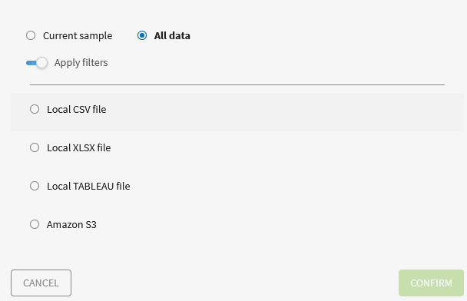
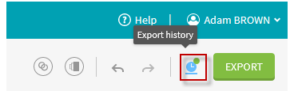
Export the data preparation results
Save the cleaned and enriched data to a delimited file, in the Windows default downloads folder.
Select the format you need.
Click CONFIRM.
Click the Export history icon.

Slide 15
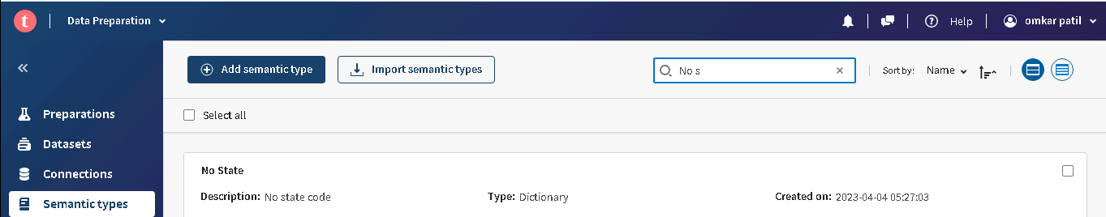
Working with semantic types
Access semantic types.
What conditions or expressions and conditions we want to apply on colums we can create semantic type an apply it.
We can create the compound to collect the children values or more values.
Regular expression we can create the expression.
Dictionary we can extract, ignore, simplify the data.
We can also import he semantic types.

Slide 16
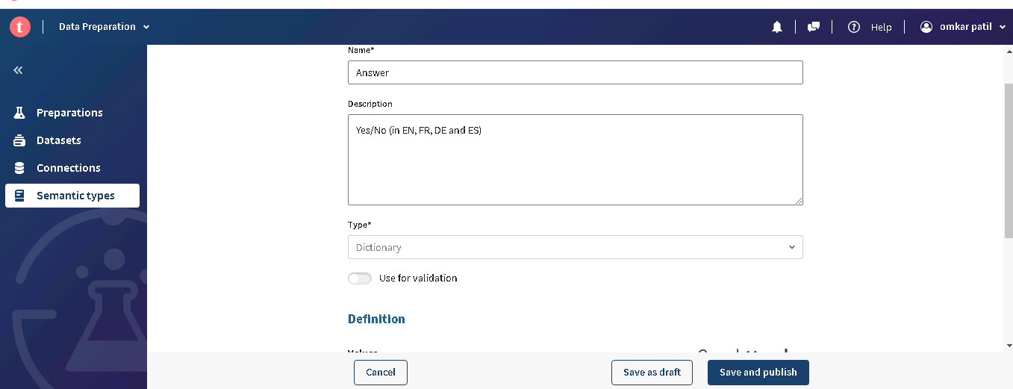
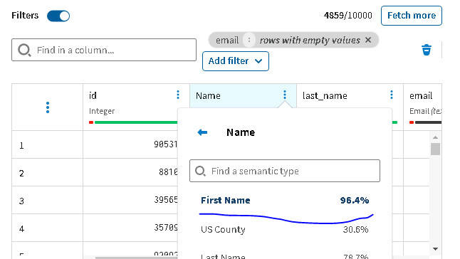

Slide 17
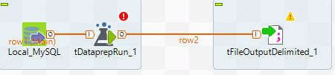
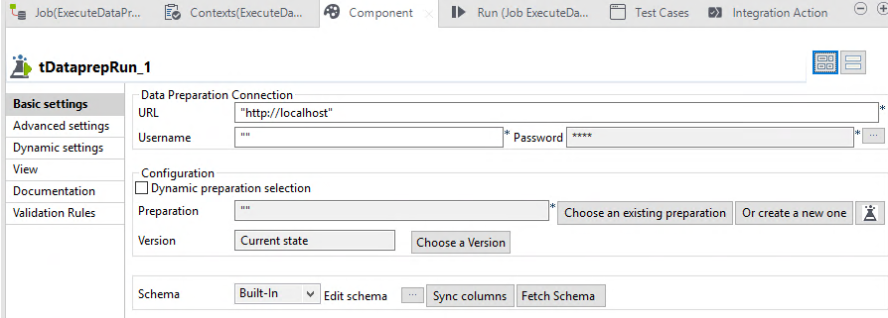
Executing a preparation in Talend Studio
Connect talend studio to talend cloud
Create a job
Between the Local_MySQLand tFileOutputDelimited components, add a tDataprepRun component.
Configure the tDataprepRun component.
Click the Edit Schema button.verify and close the schema.

Slide 18
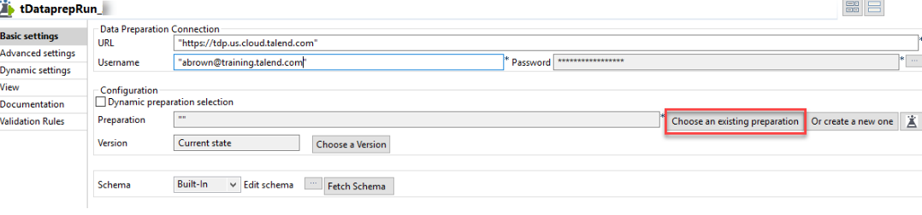
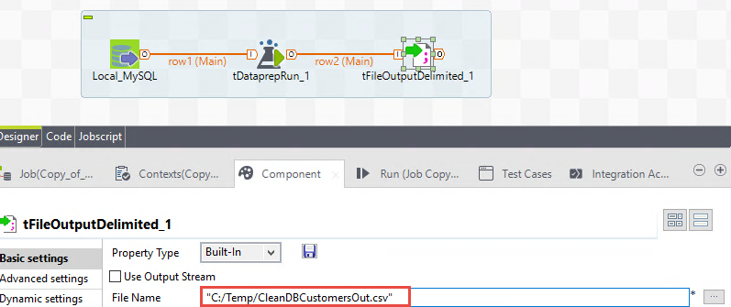
In the URL text box, enter "https://tdp.us.cloud.talend.com".
Click the Choose an existing preparation button
To see how the schema was updated, click the Edit Schema button
Update the configuration of the tFileOutputDelimited component to write the data to CleanDBCustomersOut.csv.

